Slide 1

Analysing and Predicting Eating Habits
-A Data Mining Approach.
SESHADRI RAO GUDLAVALLERU ENGINEERING COLLEGE
Department of Computer Science And Engineering
Under the Enviable and Esteemed Guidance of
Dr. G. Keerthi, MTech, Ph.D.
Assistant Professor
By
Ummadisingu Meenakshi(23485A0522)
Yerninti Lowshik Teja (22481A05Q2)
Veerla Sai Krishna (22481A05P2)

Slide 2
ABSTRACT…..
Analyzes and predicts eating habits using structured food preference data.
Uses machine learning on a multidimensional dataset (demographics, health, allergies, etc.).
Employs schema-based modelling for deeper data insights.
Builds a predictive system for personalized dietary recommendations.
Achieves high accuracy with CA and AUC .
Supports smarter, health-focused nutritional decisions.
.

Slide 3
REQUIREMENTS…..
Hardware Requirements:
Processor: Intel i5 or higher (recommended: i5/i7 for faster performance)
RAM: Minimum 4 GB (recommended: 8 GB or higher for handling larger datasets)
Hard Disk: At least 1 GB of free space for Orange and dataset storage
Display : Minimum 1024x768 resolution
Operating System: Windows 10 or higher / macOS / Linux (64-bit)
Software Requirements:
Orange Data Mining Tool:isual data analysis and modeling (version 3.x recommended)
Microsoft SSMS:Managing and querying relational databases (SQL Server)
MicrosoftVisualStudio:Development and integration environment for coding
Microsoft Excel / CSV Tool:For dataset formatting and conversion

Slide 4
PROBLEM STATEMENT…..
The classification of users based on their eating habits and personal details like age, gender, and food choices. Doing this helps in giving better food suggestions and creating personalized meal plans.
Manually dividing users into groups takes a lot of time and may not be accurate. So, this project uses machine learning to automatically group users into categories such as :Vegetarian , Non-Vegetarian, Vegan and Pescatarian.
Objectives:
Provide personalized food suggestions based on user preferences and habits.
Improve health and nutrition planning by understanding individual dietary choices.
Extract useful patterns using data mining techniques to improve food

Slide 5
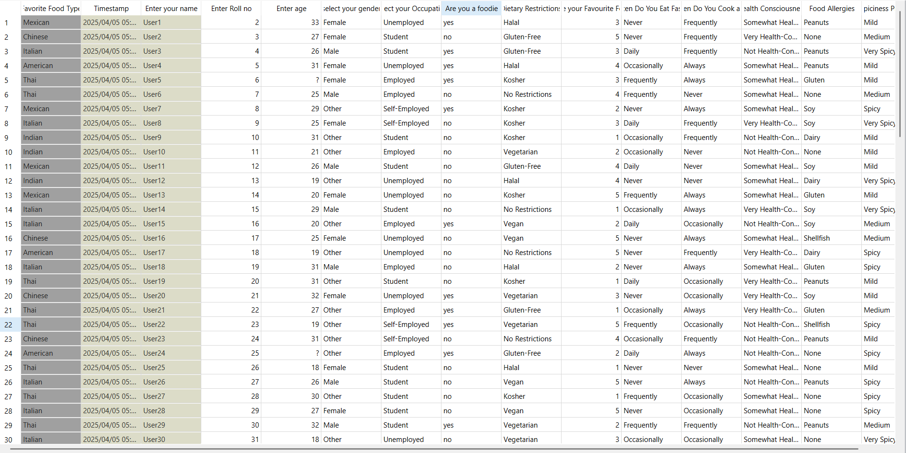
Dataset…..
Dataset is collected Using Google Form.
Link:-https://forms.gle/691fXFbDYdRM4PFA6

Slide 6
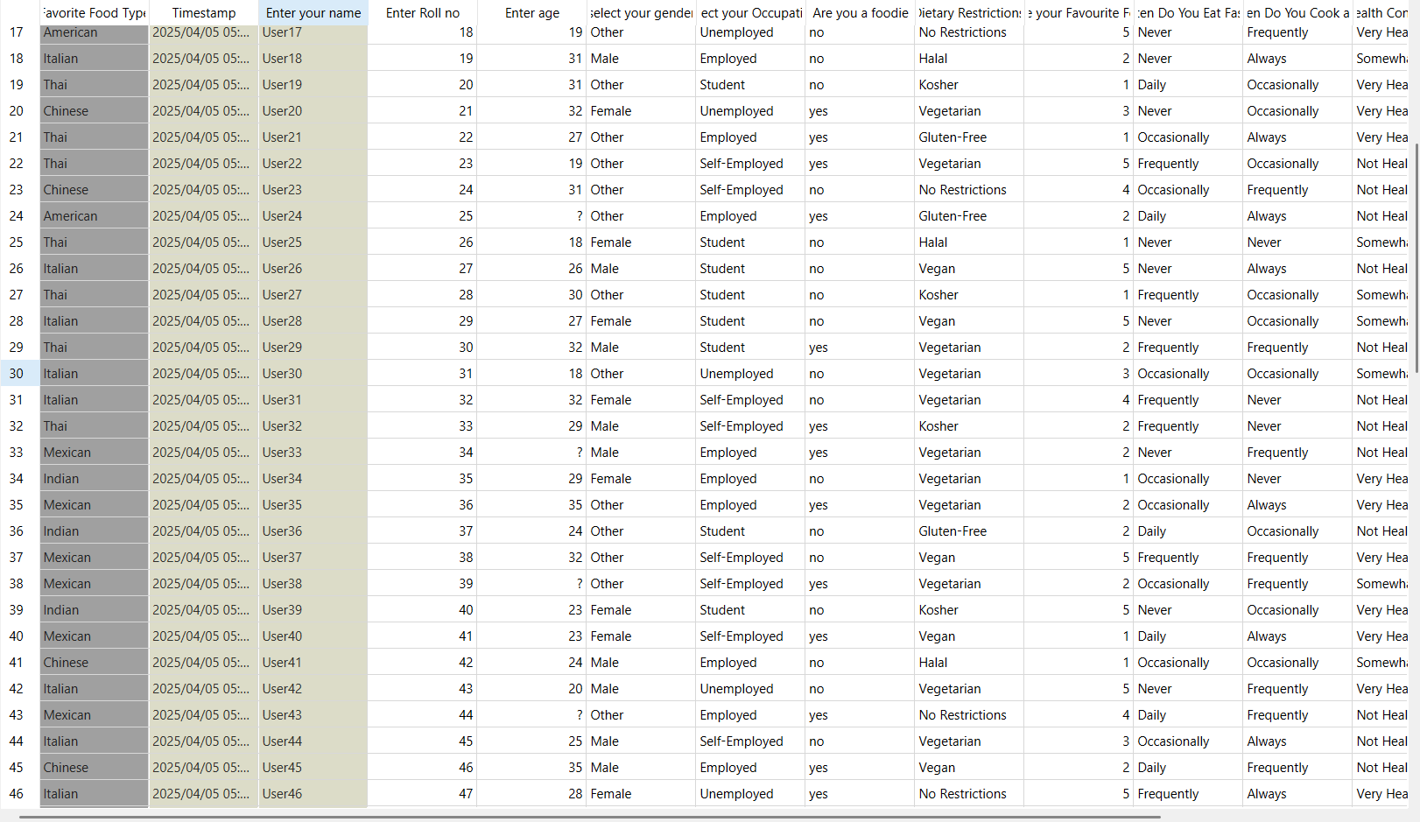
Preprocessing of dataset…..
Preprocess the Dataset Using Orange Tool.
Before imputing

Slide 7
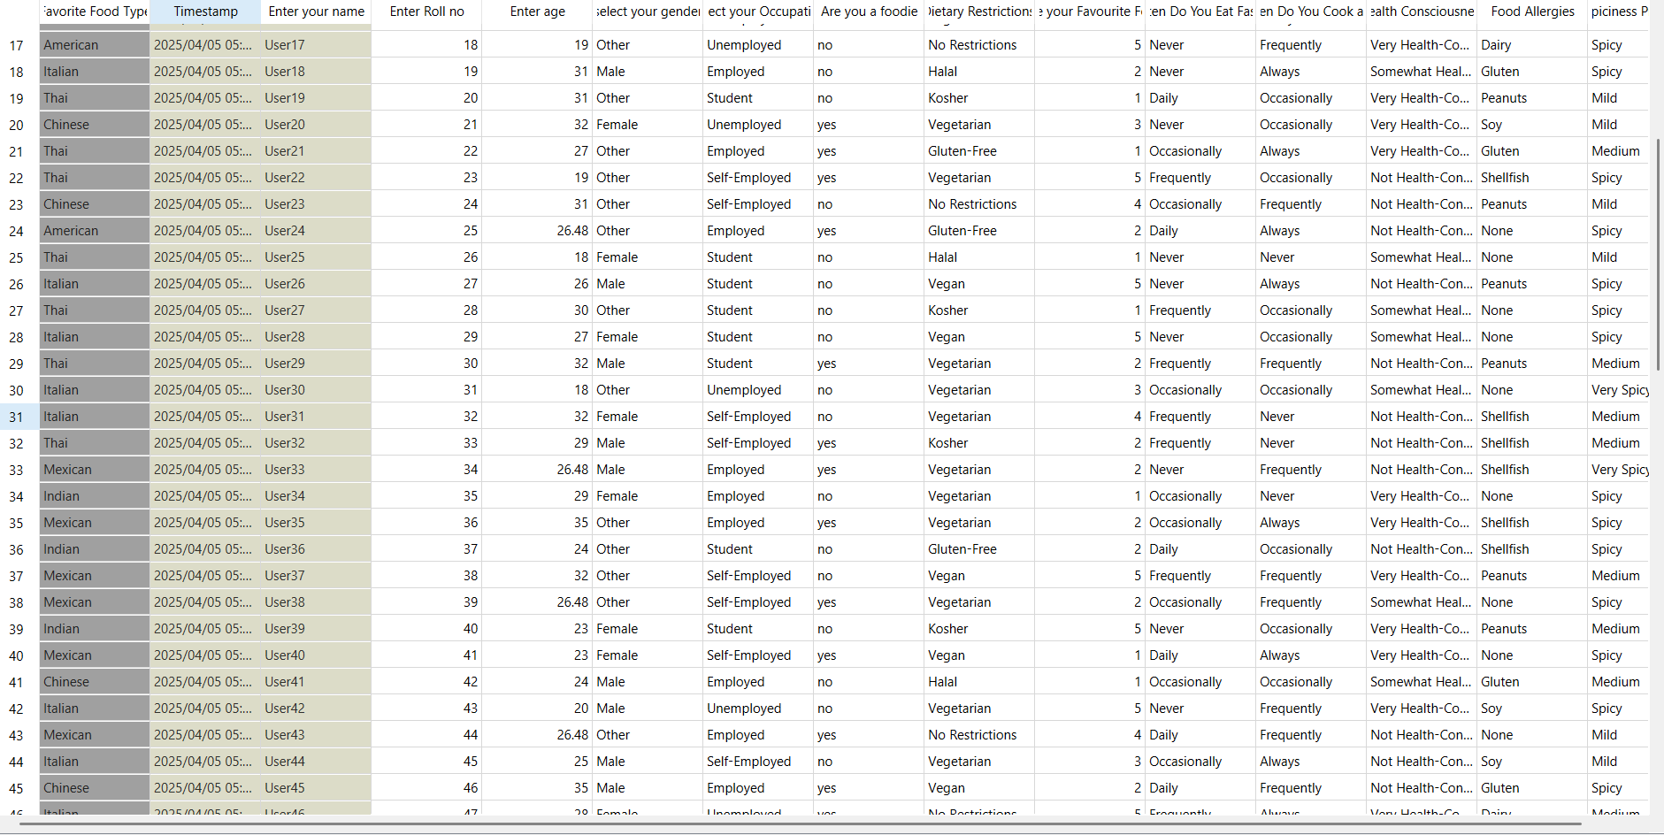
AFTER IMPUTING…..

Slide 8
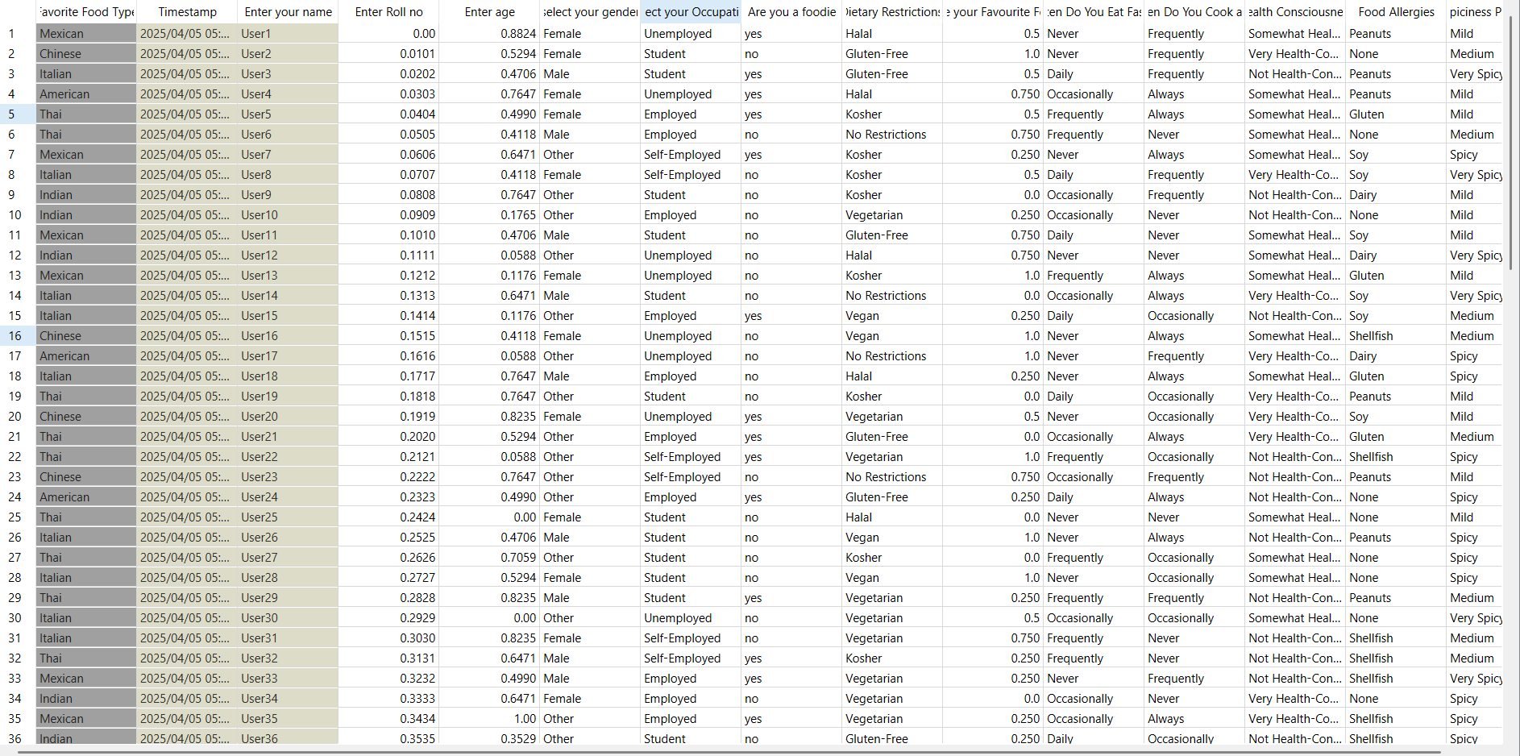
Normalized the numerical values using Normalization[0,1]
After normalization…

Slide 9
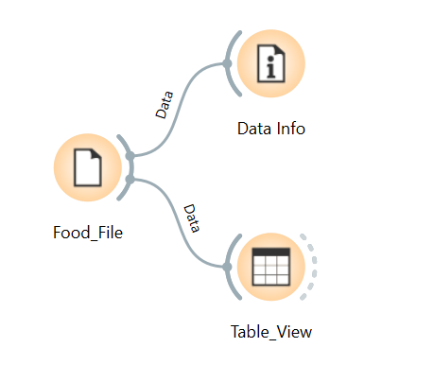
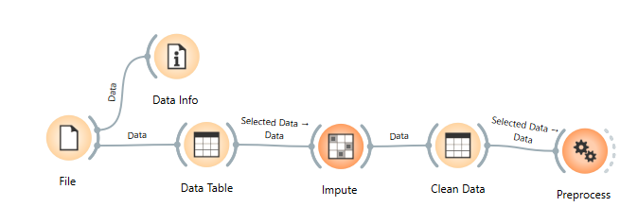
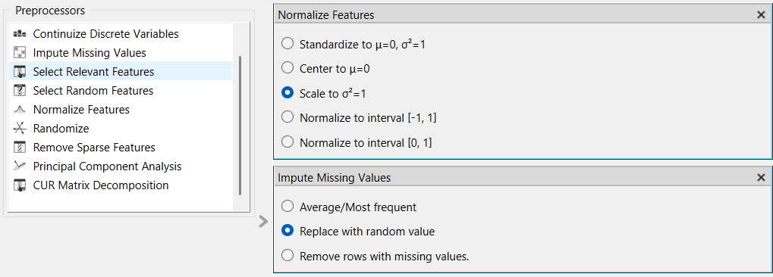
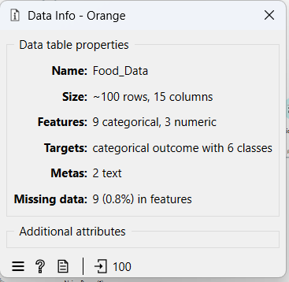
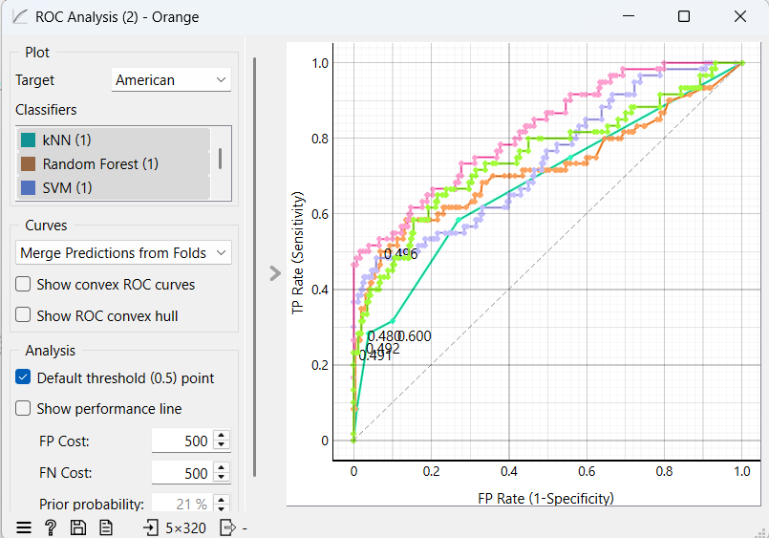
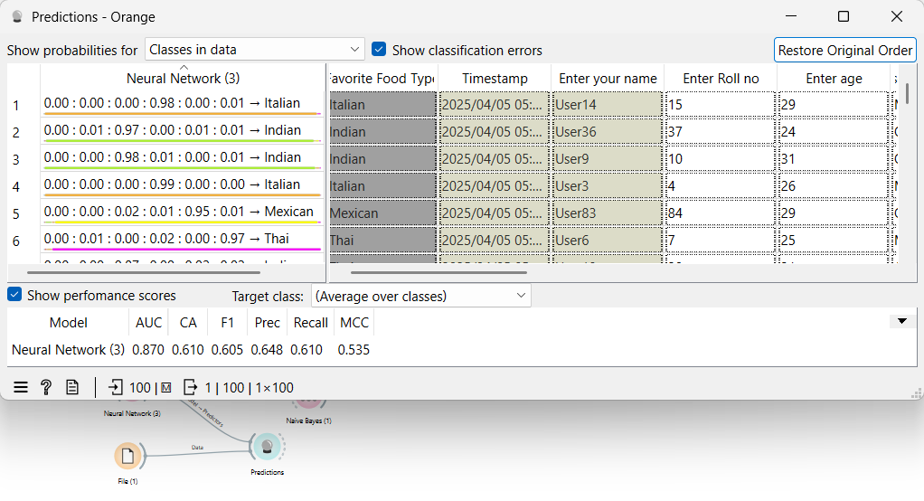
Data Mining Techniques & Outputs…..

Slide 10

Schema Creation using SQL (SSMS)…..
Part-A.
Used SQL Server Management Studio (SSMS)
  Designed tables for Fact & Dimension models
Key Actions Performed:
  Wrote SQL queries to create schemas
  Inserted preprocessed data into tables
  Created relationships between tables using foreign keys
  Created Star, Snowflake & Fact Constellation Schemas
  Used SQL Server for schema creation and data insertion
  Visualized schemas in Visual Studio (Cubes & Relationships)
Schema Types Implemented:
  Star Schema
  Snowflake Schema
  Fact Constellation Schema

Slide 11
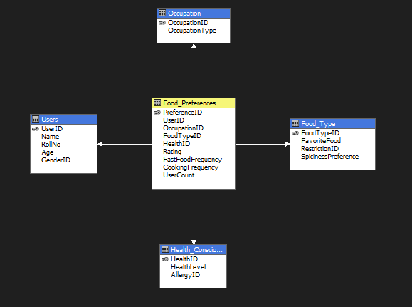
Data Warehouse & Schema Design …..
1. STAR SCHEMA.

Slide 12
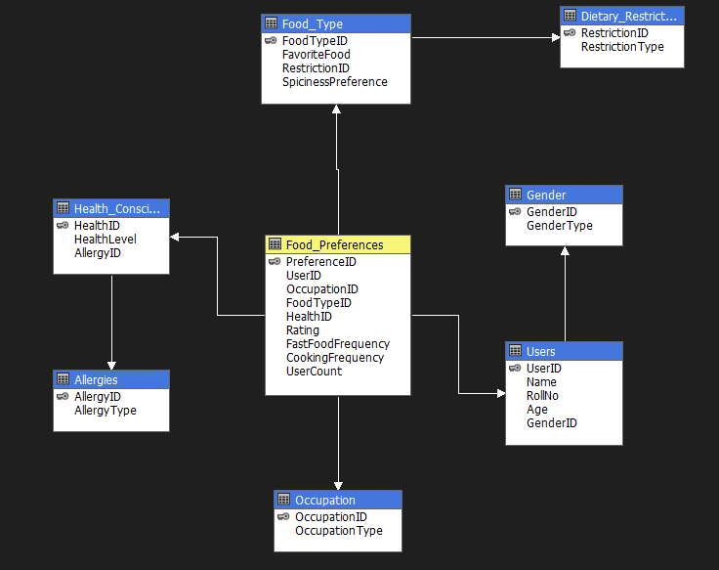
2.Snowflake schema

Slide 13
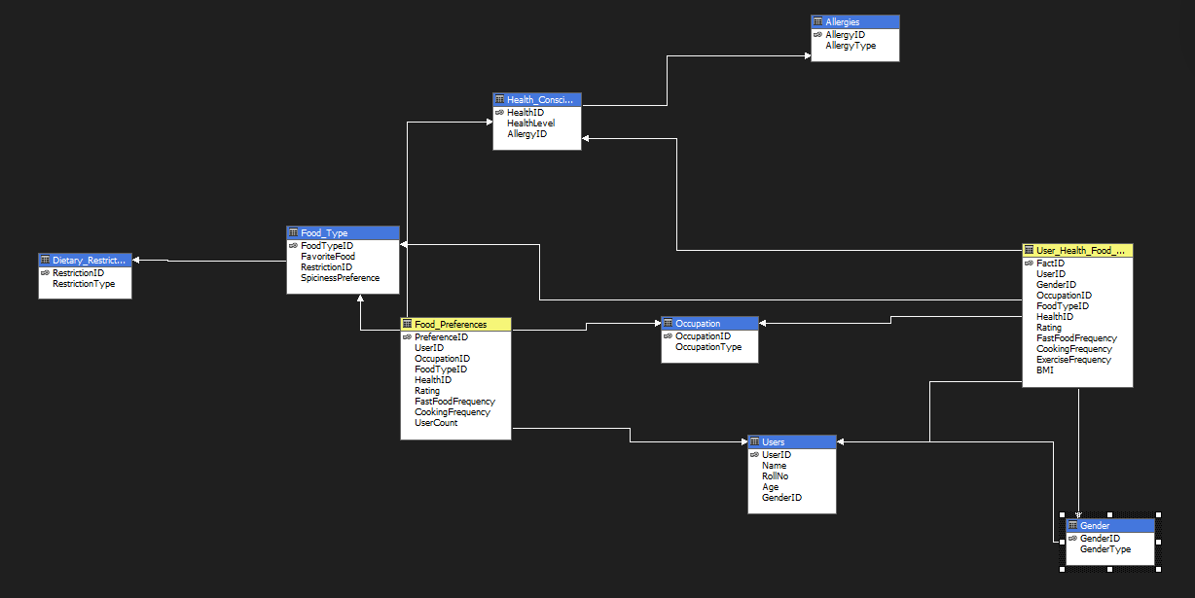
3. Fact Constellation Schema

Slide 14
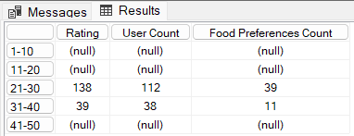
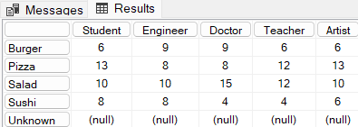
OLAP Operations & Schema Deployment…..
Deployed schemas on SSAS via Visual Studio.
Performed OLAP operations:
  Drill-Down – explore detailed data.
  Roll-Up – aggregate to higher-level data.
  Slice & Dice – analyze data from multiple perspectives.
  Pivot – Rearrange the data
1.Star schema..
Roll up:
WITH
MEMBER [Users].[Age].[1-10] AS
Aggregate({[Users].[Age].[1]:[Users].[Age].[10]})
MEMBER [Users].[Age].[11-20] AS
Aggregate({[Users].[Age].[11]:[Users].[Age].[20]})
MEMBER [Users].[Age].[21-30] AS
Aggregate({[Users].[Age].[21]:[Users].[Age].[30]})
MEMBER [Users].[Age].[31-40] AS
Aggregate({[Users].[Age].[31]:[Users].[Age].[40]})
MEMBER [Users].[Age].[41-50] AS
Aggregate({[Users].[Age].[41]:[Users].[Age].[50]})
SELECT {[Measures].[Rating],[Measures].[User Count],[Measures].[Food Preferences Count]} ON COLUMNS,
{ [Users].[Age].[1-10], [Users].[Age].[11-20], [Users].[Age].[21-30],[Users].[Age].[31-40],[Users].[Age].[41-50]} ON ROWS
FROM [FOOD_DB_STAR];
Output:-
Output:-
-------------------------------------------------------------------------------------------------------
Pivot:
SELECT
{[Occupation].[Occupation Type].[Student],[Occupation].[Occupation Type].[Engineer],
[Occupation].[Occupation Type].[Doctor],[Occupation].[Occupation Type].[Teacher],[Occupation].[Occupation Type].[Artist]} ON COLUMNS,
{[Food Type].[Favorite Food].[Favorite Food]} ON ROWS
FROM [FOOD_DB_STAR]
WHERE ([Measures].[Rating])

Slide 15
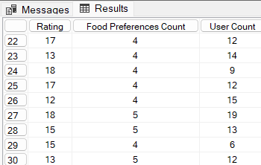
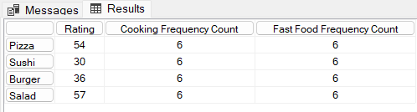
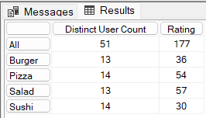
OLAP Operations & Schema Deployment…..
Output:-
Drill Down
SELECT
{[Measures].[Rating],[Measures].[Food Preferences Count],[Measures].[User Count]} ON COLUMNS,
DRILLDOWNMEMBER(
{ [Users].[Age].[20]:[Users].[Age].[30],
[Users].[Age].[31-40], [Users].[Age].[41-50] },
{[Users].[Age].[20]:[Users].[Age].[30]} -- Expanding 20-30 into individual values
) ON ROWS
FROM [FOOD_DB_STAR];
------------------------------------------------------------------------------------------------
Output:-
Slice
WITH
MEMBER [Measures].[Cooking Frequency Count] AS
COUNT([Food Preferences].[Cooking Frequency].MEMBERS)
MEMBER [Measures].[Fast Food Frequency Count] AS
COUNT([Food Preferences].[Fast Food Frequency].MEMBERS)
SELECT {[Measures].[Rating], [Measures].[Cooking Frequency Count], [Measures].[Fast Food Frequency Count]} ON COLUMNS,
{[Food Type].[Favorite Food].[Pizza], [Food Type].[Favorite Food].[Sushi],
[Food Type].[Favorite Food].[Burger],[Food Type].[Favorite Food].[Salad]} ON ROWS
FROM [FOOD_DB_STAR]
---------------------------------------------------------------------------------------------
Output:-
Dice
WITH
MEMBER [Measures].[Distinct User Count] AS
DISTINCTCOUNT([Users].[User ID].MEMBERS)
SELECT
{[Measures].[Distinct User Count],[Measures].[Rating]} ON COLUMNS,
NONEMPTY(
[Food Type].[Favorite Food].MEMBERS,
[Occupation].[Occupation Type].MEMBERS) ON ROWS
FROM [FOOD_DB_STAR]

Slide 16
Concept Hierarchy used in star schema…..
Age groups
Age
Age
Age groups
Roll-up
Drill Down

Slide 17

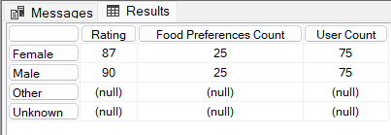

OLAP Operations & Schema Deployment…..
2.SnowFlake schema..
Roll up:
SELECT
{[Measures].[Rating],
[Measures].[Food Preferences Count],
[Measures].[User Count]}
ON COLUMNS,
{[Users 1].[Gender Type].[All]}
ON ROWS
FROM [FOOD_DB_SNOWFLAKE]
Output:-
-----------------------------------------------------------------------------------
Output:-
Drill Down:
SELECT
{[Measures].[Rating], [Measures].[Food Preferences Count],
[Measures].[User Count]}
ON COLUMNS,
{[Users 1].[Gender Type].Children}
ON ROWS
FROM [FOOD_DB_SNOWFLAKE]
----------------------------------------------------------------------------------------------
Slice:
SELECT
{[Measures].[Rating],
[Measures].[Food Preferences Count],
[Measures].[User Count]}
ON COLUMNS
FROM [FOOD_DB_SNOWFLAKE]
WHERE ({[Users 1].[Name].[Mia Young],[Users 1].[Name].[Harper Baker]})
Output:-

Slide 18
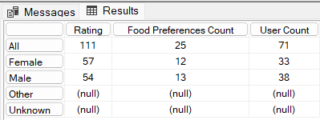
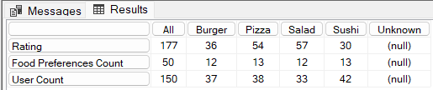
OLAP Operations & Schema Deployment…..
Dice:
SELECT
{[Measures].[Rating],
[Measures].[Food Preferences Count],
[Measures].[User Count]}
ON COLUMNS,
{[Users 1].[Gender Type].Members}
ON ROWS
FROM [FOOD_DB_SNOWFLAKE]
WHERE ({[Food Type 1].[Favorite Food].[Pizza], [Food Type 1].[Favorite Food].[Salad]})
Output:-
----------------------------------------------------------------------------------
Output:-
Pivot:
SELECT
{[Food Type 1].[Favorite Food].Members} ON COLUMNS,
{[Measures].[Rating],
[Measures].[Food Preferences Count],
[Measures].[User Count]} ON ROWS
FROM [FOOD_DB_SNOWFLAKE]

Slide 19
Concept Hierarchy used in snowflake schema…..
Individual
All Genders
All Genders
Individual
Roll-up
Drill Down

Slide 20
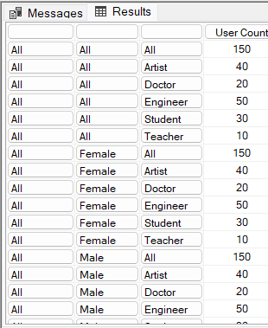

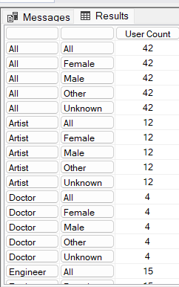
OLAP Operations & Schema Deployment…..
3. Fact Constellation schema..
Roll up:
SELECT
{[Measures].[User Count]} ON COLUMNS,
NON EMPTY CROSSJOIN(
[Health Consciousness 2].[Health Level].MEMBERS,
[Gender].[Gender Type].MEMBERS,
[Occupation 2].[Occupation Type].MEMBERS
) ON ROWS
FROM [FOOD_DB_FACT]
Output:-
-------------------------------------------------------------------------------
Output:-
Drill down:
SELECT
{[Measures].[User Count],[Measures].[BMI],[Measures].[Rating - User Health Food Fact]} ON COLUMNS,
NON EMPTY
[Food Type 2].[Favorite Food].MEMBERS ON ROWS
FROM [FOOD_DB_FACT]
WHERE {([Food Type 2].[Restriction Type].[Vegan])}
-------------------------------------------------------------------------------
Output:-
Slice:
SELECT
{[Measures].[User Count]} ON COLUMNS,
NON EMPTY
CROSSJOIN(
[Occupation 2].[Occupation Type].MEMBERS,
[Gender].[Gender Type].MEMBERS
) ON ROWS
FROM [FOOD_DB_FACT]
WHERE ([Food Type 2].[Restriction Type].[Vegan])

Slide 21
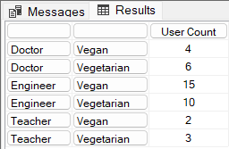
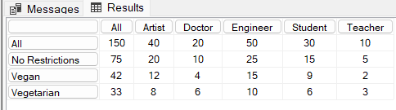
OLAP Operations & Schema Deployment…..
Dice:
SELECT
{[Measures].[User Count]} ON COLUMNS,
NON EMPTY
FILTER(
CROSSJOIN( [Occupation 2].[Occupation Type].MEMBERS, [Food Type 2].[Restriction Type].MEMBERS),
([Occupation 2].[Occupation Type].CURRENTMEMBER IS [Occupation 2].[Occupation Type].[Doctor] OR
[Occupation 2].[Occupation Type].CURRENTMEMBER IS [Occupation 2].[Occupation Type].[Engineer] OR
[Occupation 2].[Occupation Type].CURRENTMEMBER IS [Occupation 2].[Occupation Type].[Teacher])
AND
( [Food Type 2].[Restriction Type].CURRENTMEMBER IS [Food Type 2].[Restriction Type].[Vegetarian] OR
[Food Type 2].[Restriction Type].CURRENTMEMBER IS [Food Type 2].[Restriction Type].[Vegan] OR
[Food Type 2].[Restriction Type].CURRENTMEMBER IS [Food Type 2].[Restriction Type].[Gluten-Free]))
ON ROWS
FROM [FOOD_DB_FACT]
Output:-
--------------------------------------------------------------------------------------------
Output:-
Pivot:
SELECT
NON EMPTY [Occupation 2].[Occupation Type].MEMBERS ON COLUMNS,
NON EMPTY [Food Type 2].[Restriction Type].MEMBERS ON ROWS
FROM [FOOD_DB_FACT]
WHERE ([Measures].[User Count])

Slide 22
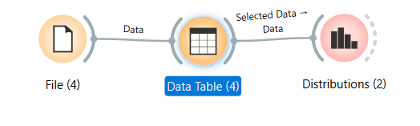
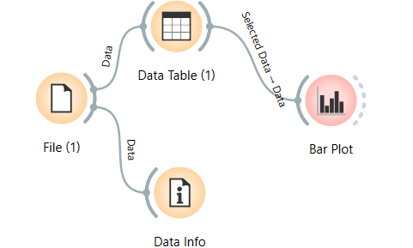
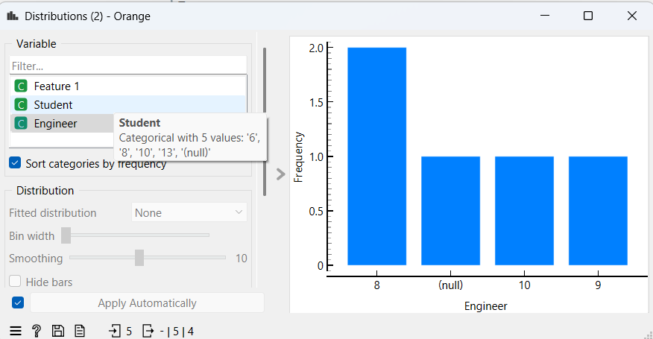
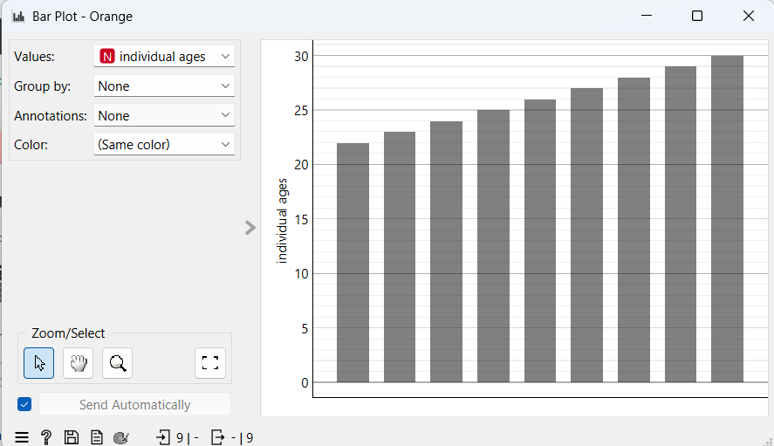
OLAP Operations & Visualization…..
OLAP results were exported and cleaned in Excel.
Handled missing values manually for accurate visual output.
Final visualizations created using Orange Tool to identify user trends and behaviors.

Slide 23
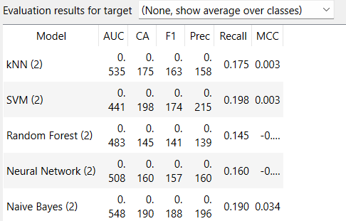
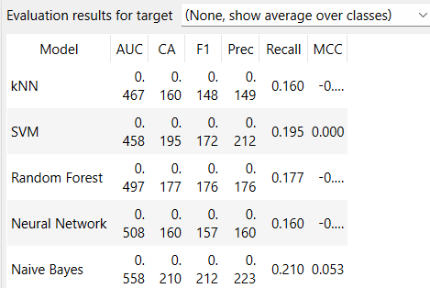
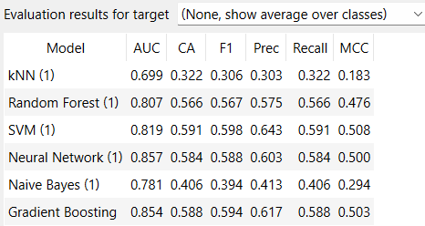
Perform Data Mining on the Dataset…..
Remove the noise data.
Apply preprocessing technique to the cleaned data.
And then use test score to decide that which model is best.
So then finally we can perform prediction.
Without preprocessing
With preprocessing
With preprocessing and Data Sampler
Gradient Boosting and svm has the most accuracy.

Slide 24
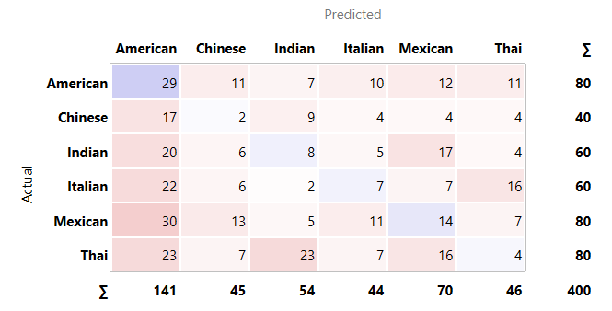
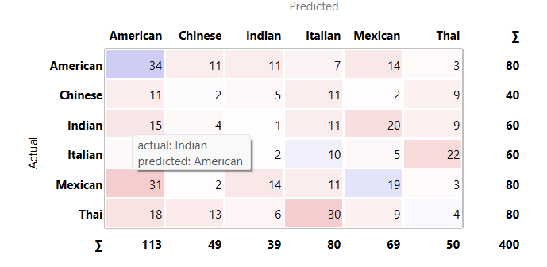
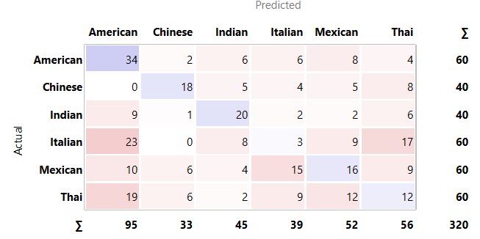
EVALUATION METRICS…..
With preprocessing
Without preprocessing
With preprocessing with Data Sampler

Slide 25
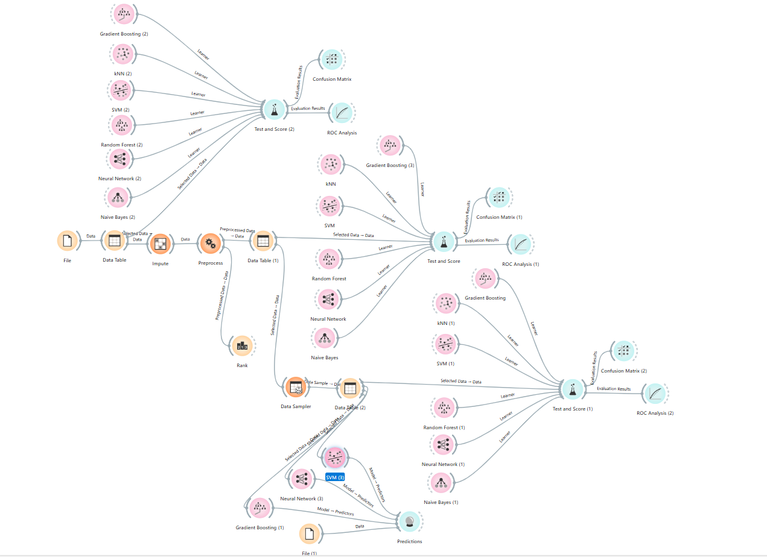
OVERALL WORKFLOW ……

Slide 26
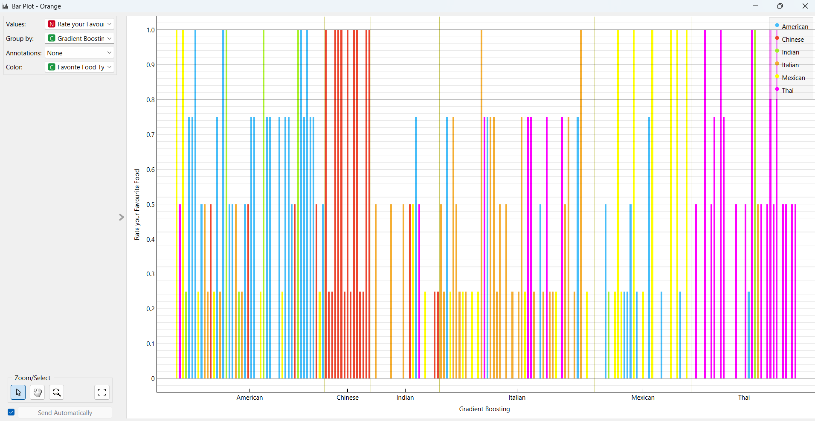
Bar plot –Analysis…..

Slide 27
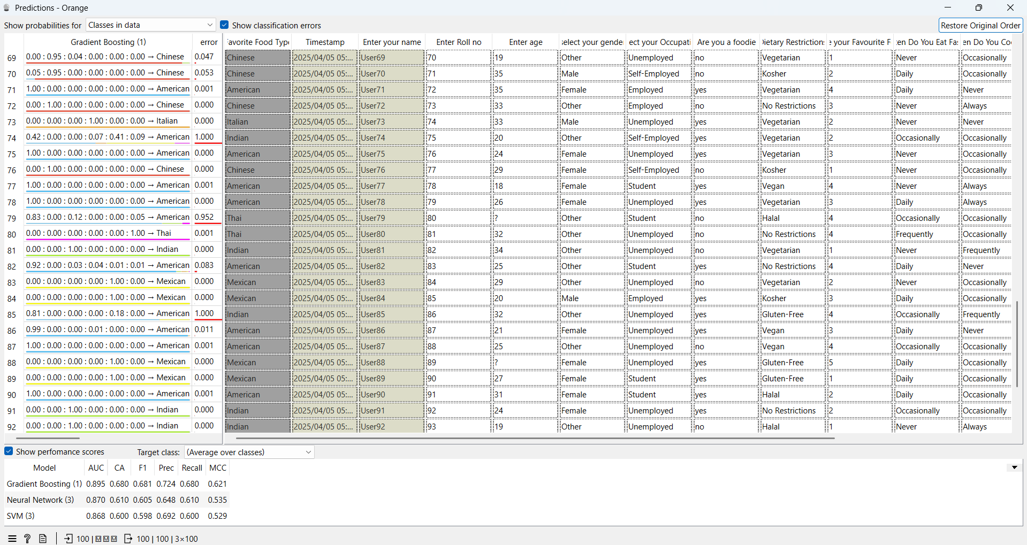
Predictions…..

Slide 28
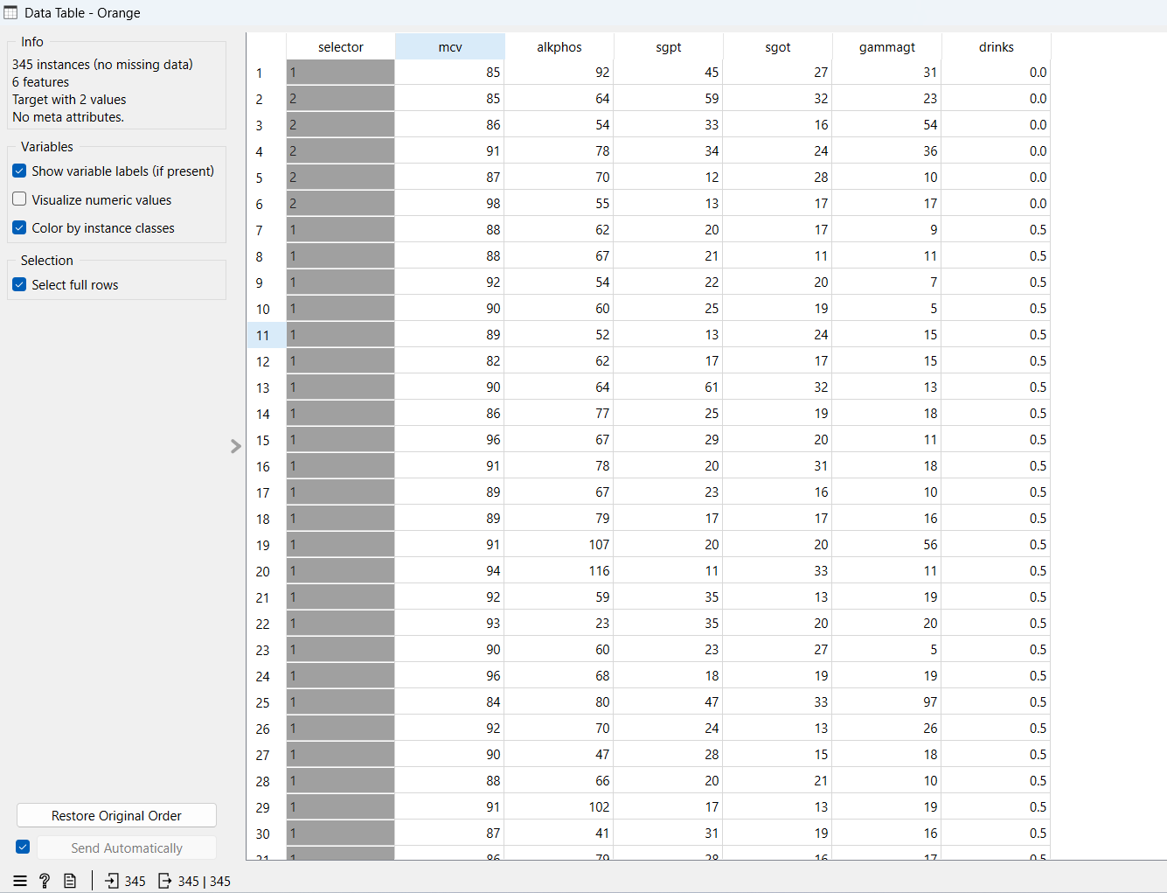
Predictive Modeling and Regression Analysis on the Bupa Dataset Using Orange…..
Part-B.
Dataset:
The BUPA Liver Disorders Dataset contains records of liver function test results used to predict the likelihood of liver disorders, primarily influenced by excessive alcohol consumption. It is widely used in machine learning for classification problems.

Slide 29
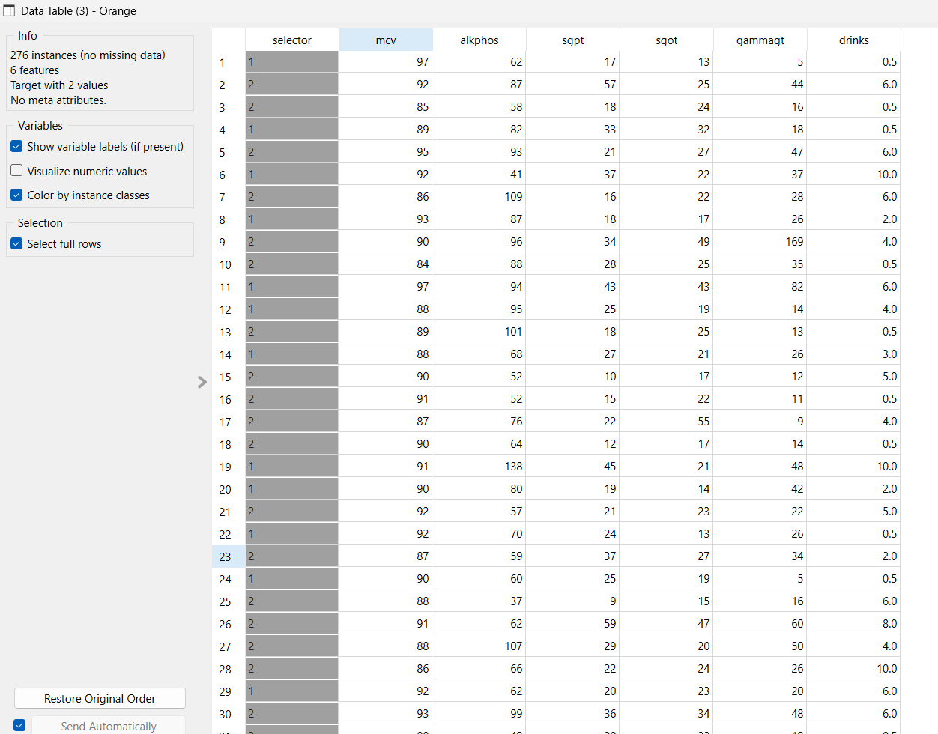
Preprocessing of Dataset…..

Slide 30
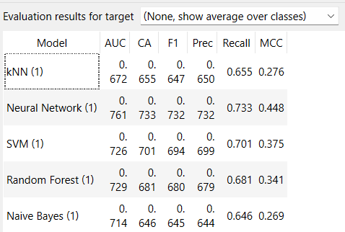
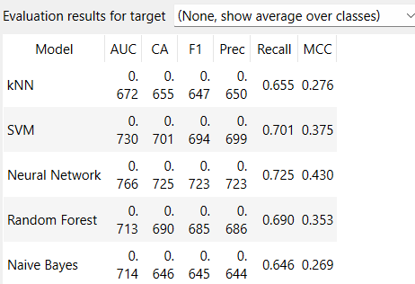
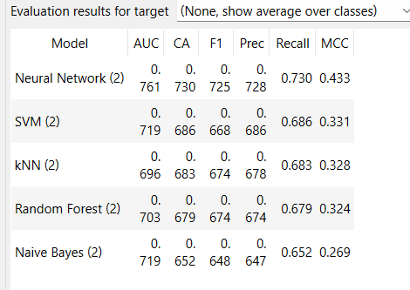
Test and Score values…..
Without preprocessing
With preprocessing
With data sampler

Slide 31
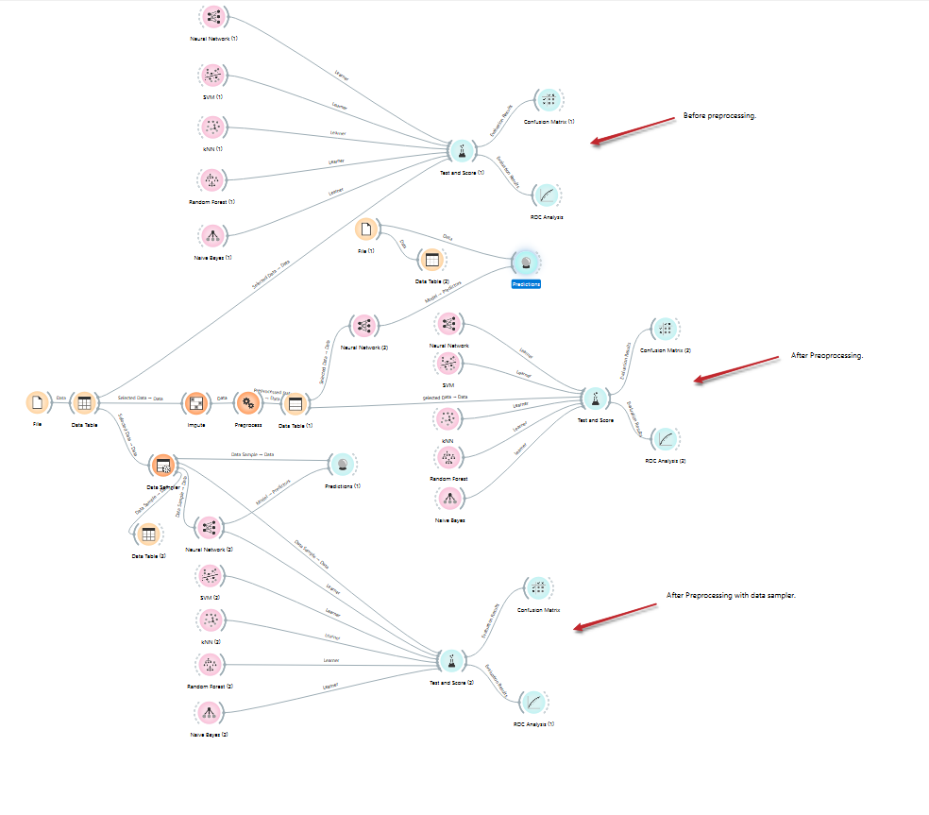
OVERALL WORKFLOW ……

Slide 32
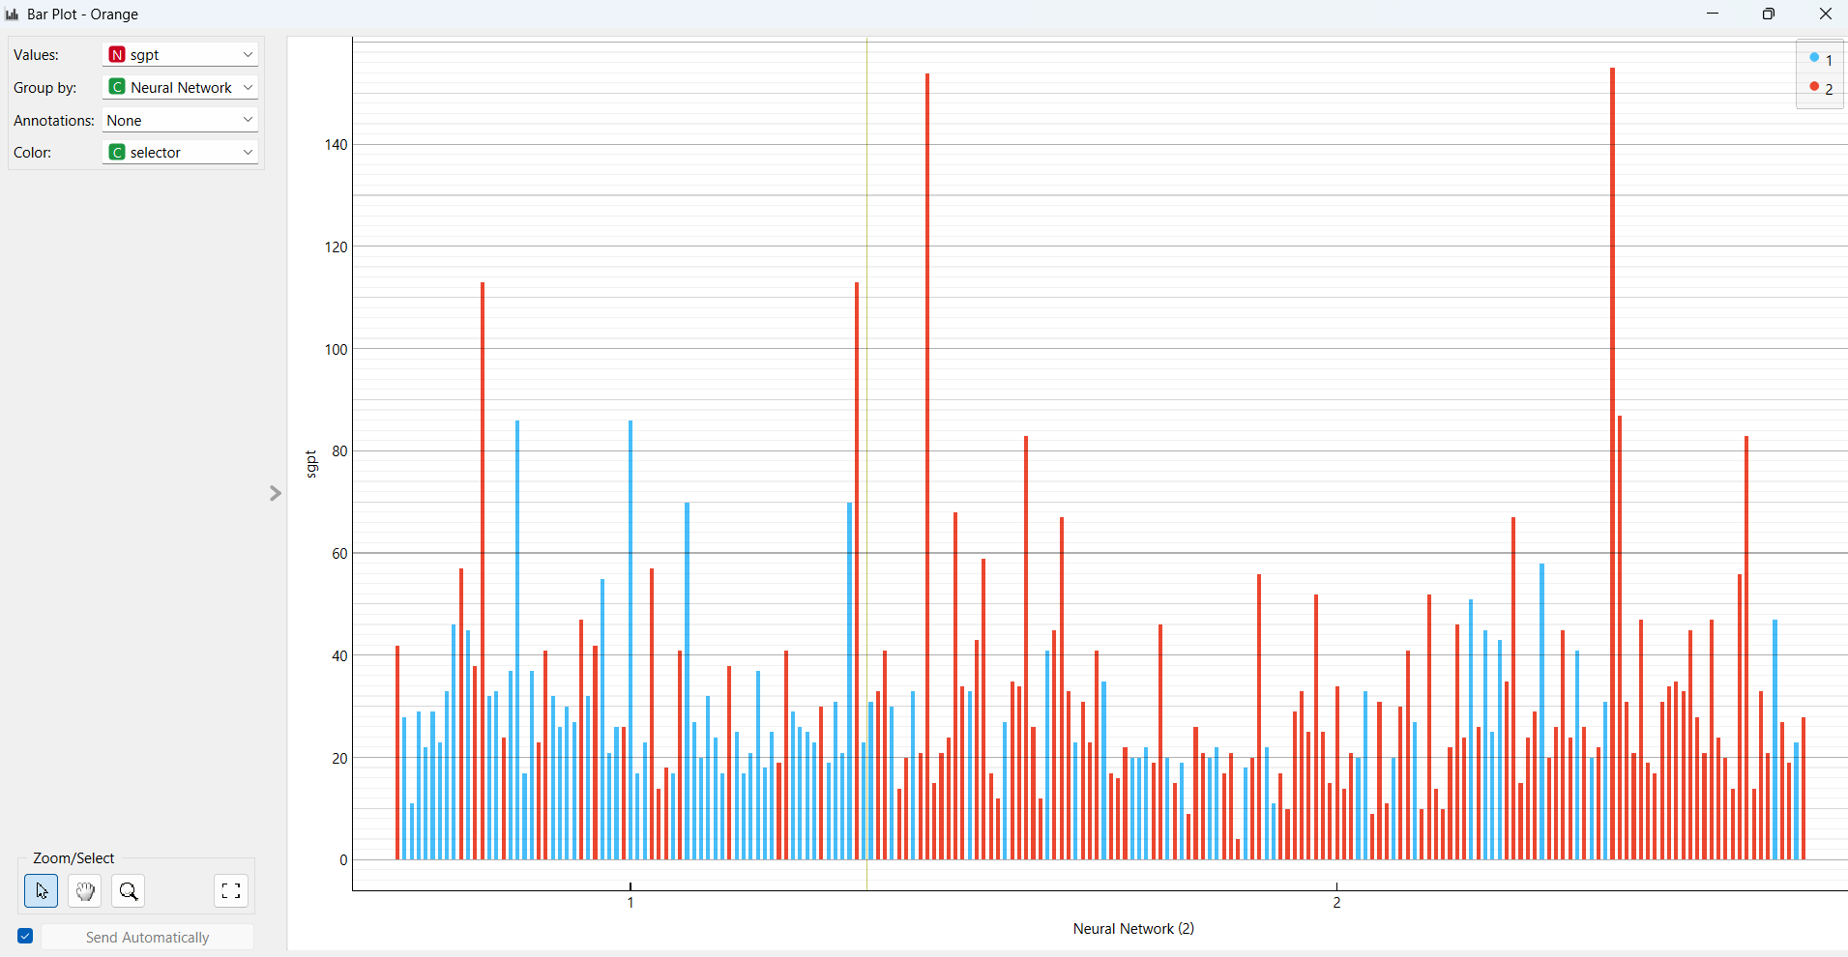
Bar plot-Analysis…..

Slide 33
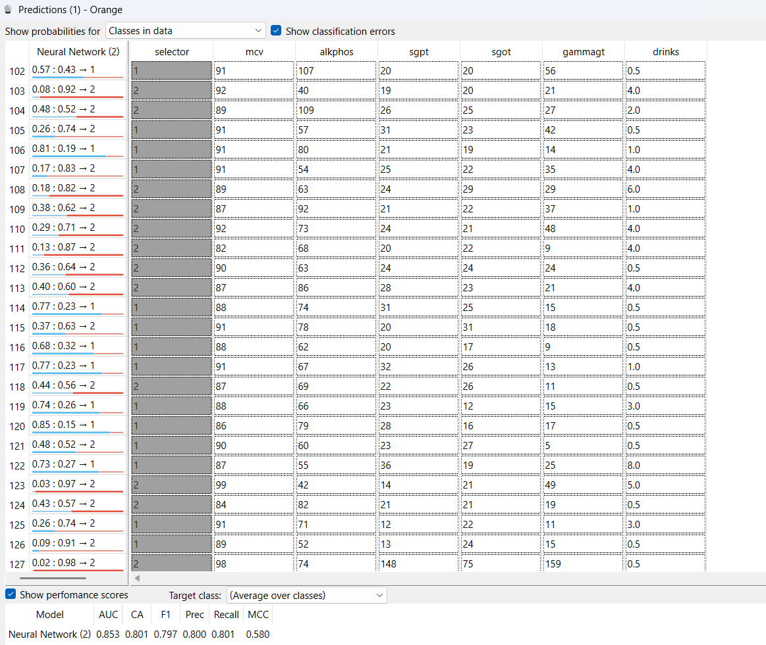
Predictions…..

Slide 34
FINAL ANALYSIS……
Part-C.
Experimental Analysis:Comparing Two Test Scenarios in Orange
We’re comparing two complete experiments:
First Experiment: Using Test & Score with different combinations (no preprocessing, with preprocessing, and with preprocessing + data sampler).
It introduces Gradient Boosting, which outperformed all others in that setup.
Gradient Boosting (CA = 0.588, F1 = 0.617)
Second Experiment: Focused on test and score values across the same three combinations but likely applied on a more tuned dataset.
This clearly shows better overall performance across most models :
A more refined preprocessing approach.
Possibly better feature selection and clean input data.
Neural Network (CA = 0.761, F1 = 0.730)

Slide 35
CONCLUSION…..
Preprocessing is critical – without it, most models produce poor or invalid results.
Combining preprocessing with sampling gives the best performance by balancing the dataset.(in both the datasets used)
Gradient Boosting, SVM, and Neural Network are the most effective models for this problem.

Slide 36
Thank you.

