Slide 1

Community Service Project
Weather & Species Info for Aquafarmers
By
V.SAI KRISHNA (22481A05P2)
U.LOKESH (22481A05N7)
CH.ENOSH (22485A0506)
Under the guidance of
Dr. T.Nagamani, M. Tech ,Phd
Assistant Professor, Department of Computer Science and Engineering.

Slide 2
ABSTRACT:
Location-based Weather: The app shows local weather and checks if it matches what the selected species needs to live comfortably.
Species Search: Users can search for a species to find information about where it lives, how long it lives, and the climate it likes best.
Precaution Suggestions: If the weather isn’t suitable, the app suggests ways to make the area more comfortable for the species, like tips for adjusting temperature or moisture levels.

Slide 3
Objectives:-
Provide Species Information – Help users learn about species’ habitats, lifespans, and climate needs.
Analyze Weather – Show if the local weather suits the chosen species.
Suggest Tips – Offer suggestions to make the area more comfortable for species if the weather doesn’t match their needs.
Promote Environmental Awareness – Encourage users to understand and support species’ needs for better environmental care.

Slide 4
SCOPE:
Species Database – Providing a variety of species profiles with detailed information.
Weather Analysis – Offering real-time, location-based weather data to check climate suitability for species.
Adaptation Suggestions – Giving practical tips to help users create suitable conditions if the climate isn’t ideal.
User Engagement – Featuring an easy-to-use, visually appealing interface that encourages learning and exploration about species and their needs.

Slide 5
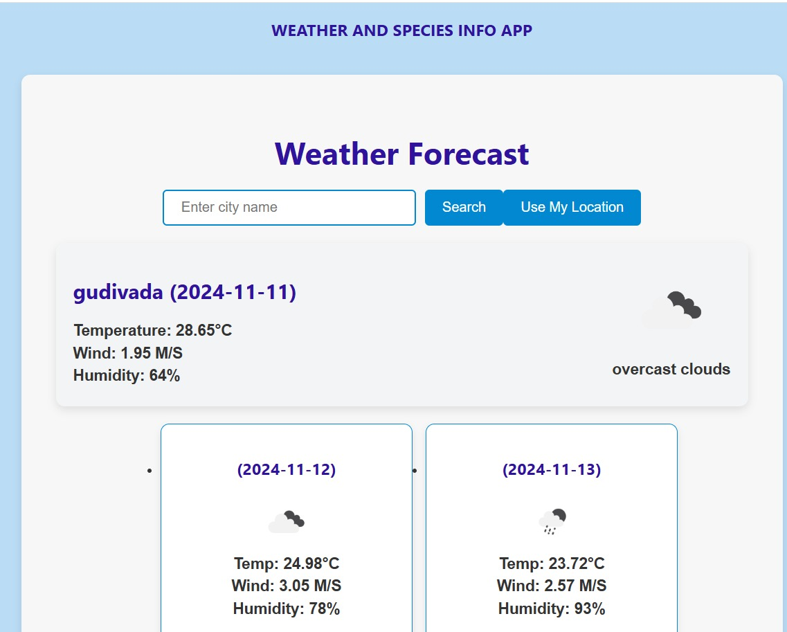
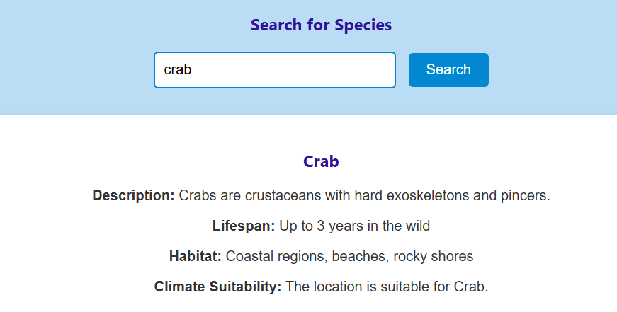
INTERFACE for suitable condition:

Slide 6
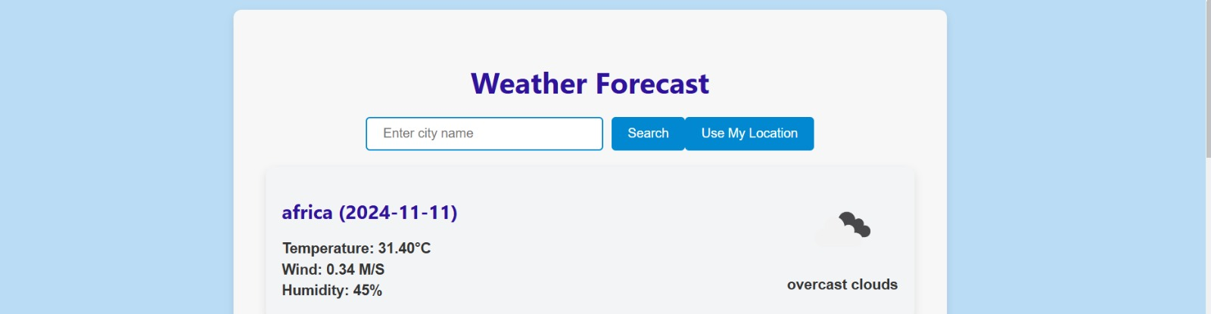
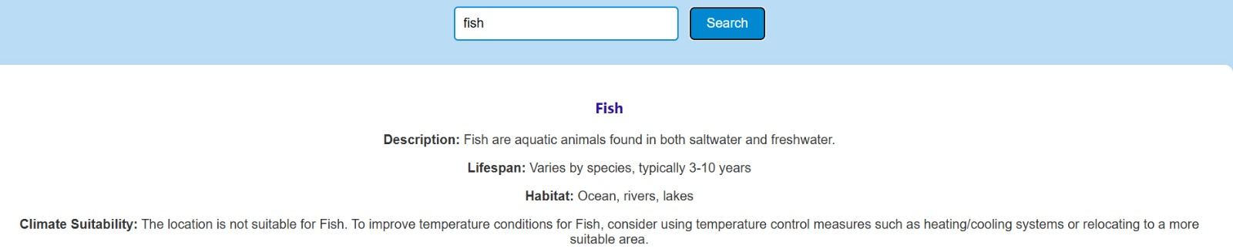
Interface for non-suitable condition:

Slide 7
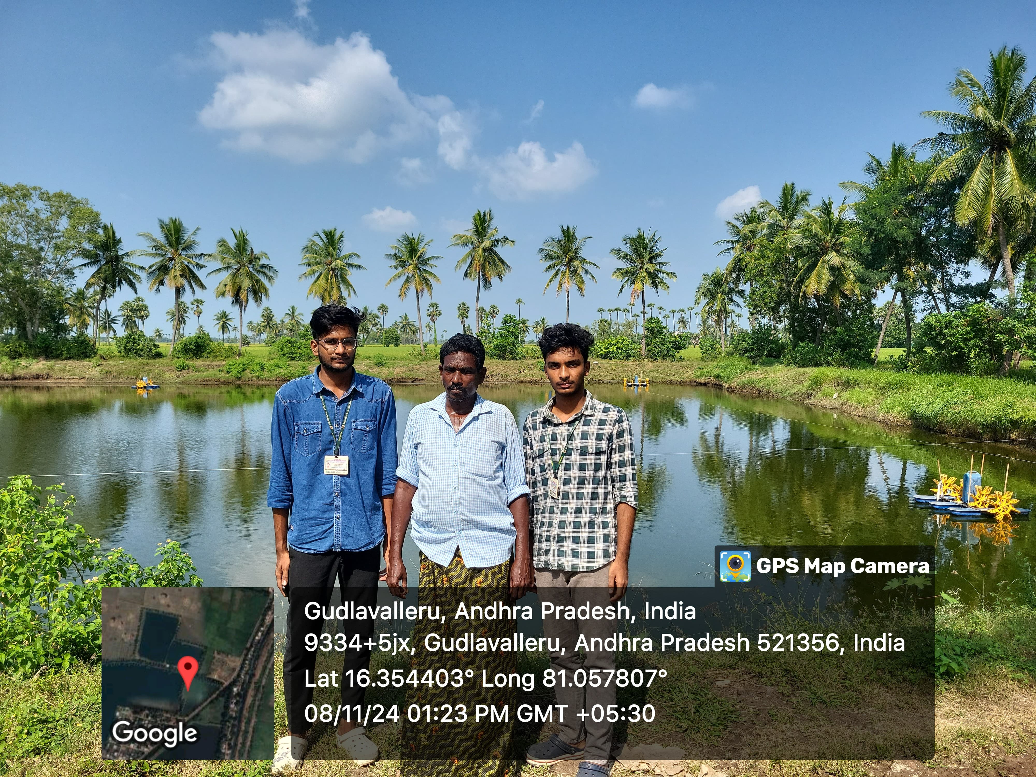
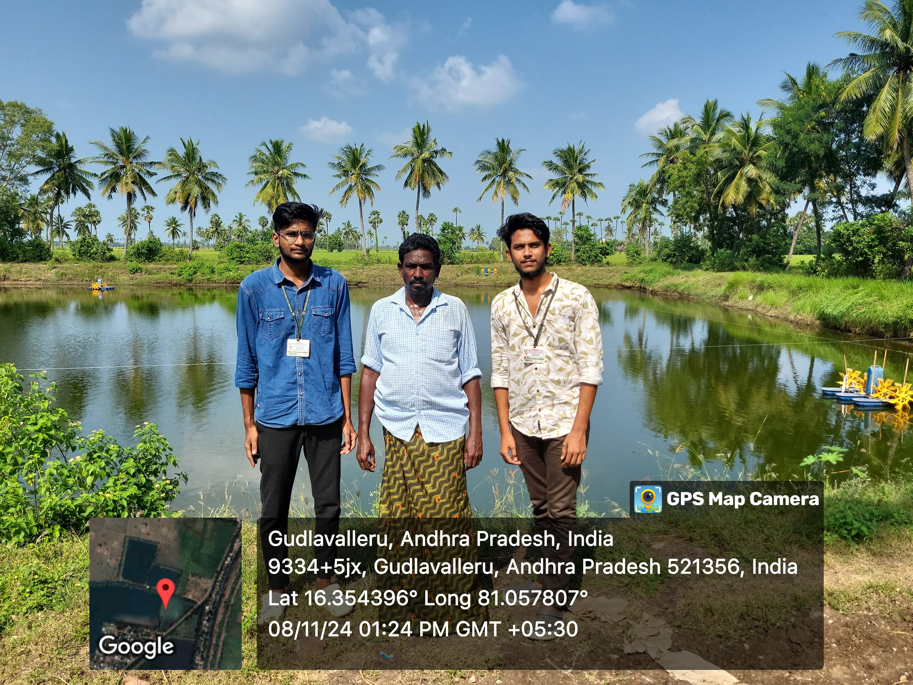
CONCLUSION:
This app helps users learn about different species and check if the weather around them is good for those species. If the weather isn't right, it gives tips on how to make it better. It’s an easy-to-use tool for anyone interested in nature and protecting the environment.

Slide 8


